Slide 1
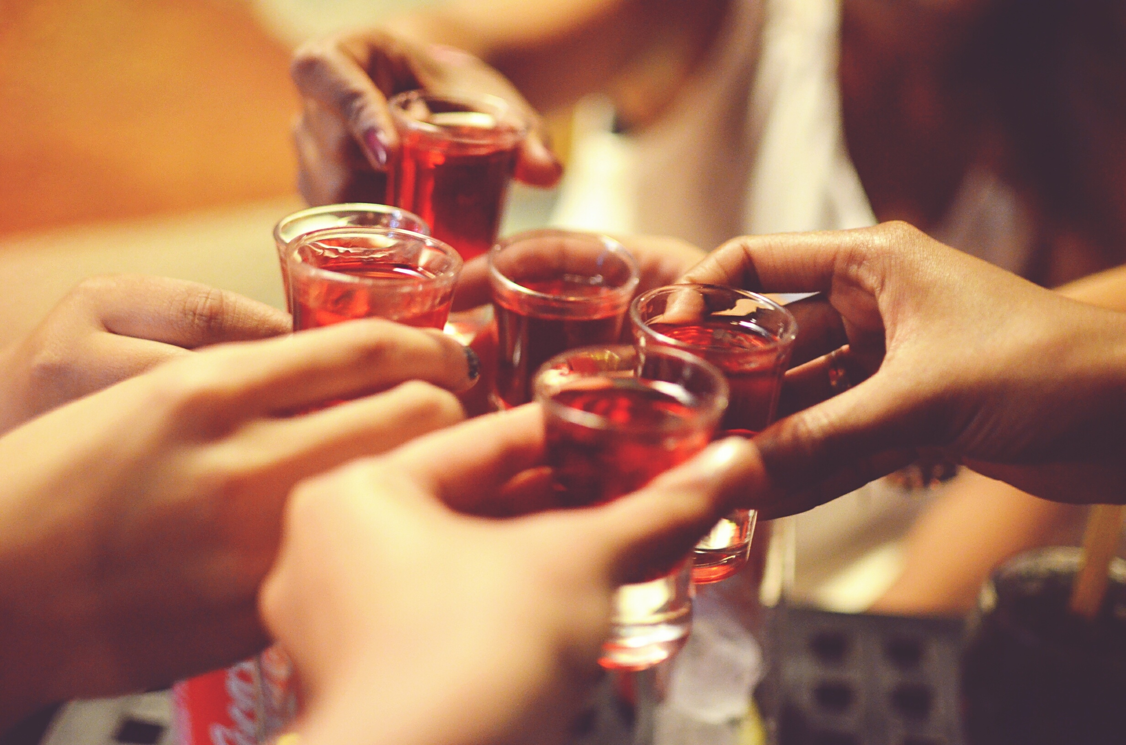
Effect of alcohol consumption on student grades
John, Eden, Michael

Slide 2
TECHNOLOGY
Python/Pandas
Sklearn/SVM Machine Learning
Tableau
HTML/CSS/Bootstrap
Heroku

Slide 3
Data Source
https://www.kaggle.com/uciml/student-alcohol-consumption
1044 rows/33 columns
Focused on weekend and weekday drinking compared to student grades

Slide 4
Problem Being Addressed
How much, as a student, can you drink and maintain a “C” grade
We dove into the data as far as daily vs weekend alcohol consumtion and its effect on student grades
Impact of age, study time and free time

Slide 5
Conclusion
Actual and predicted data showed that students can be heavy drinkers on both the weekend and weekdays and still pass with a “C”. However, if their goal is an “A” then they will need to reduce to a low level of drinking.
Let’s go explore the Data…
https://data-bootcamp-project-3.herokuapp.com/home.html

